Slide 1

Sage – Creating a New Ethical Framework
GROUP 8
Angelos Nikolas
Lloyd Bates
Kangle Sun
Sahej Sareen
Hugo Salgado
Avi Gupta

Slide 2
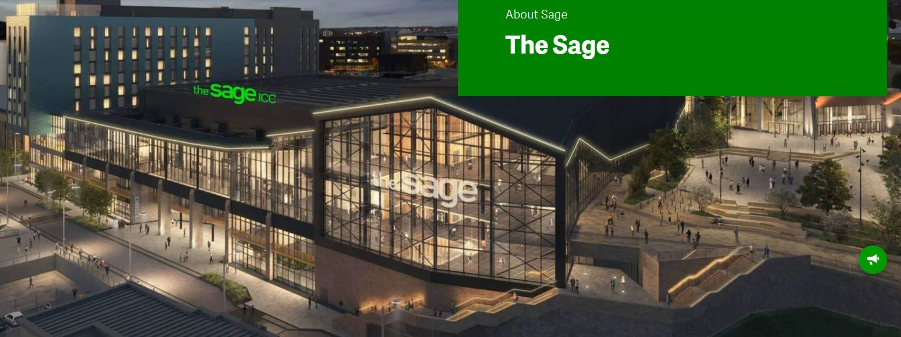
Who is Sage?
The proud market leader in cloud business management solutions, supporting thousands of small and medium size businesses globally.

Slide 3
Solution Definition
Our framework will help Sage retain existing customers by defining ethical boundaries to prevent customer distrust and appeal to new demographics.

Slide 4
Problem: Defining Ethics
Motivation:
Ethics is a subjective issue but is ultimately tied to the company's image and reputation.
Problem:
How can Sage define the ethical boundaries with different culture of customers and team members?
Can Sage secure and expand their market share by working within the ethical boundaries?

Slide 5
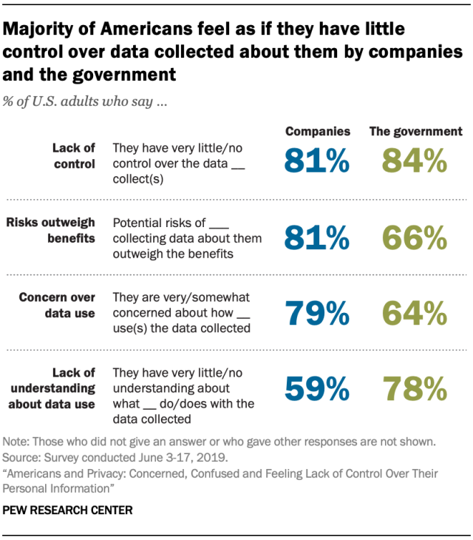
People increasingly care about data
Studies by Pew Research Center show that around 80% of adults feel like they have little control of how data is collected and used and feel like risks of sharing data may outweigh benefits.

Slide 6
Solution : Defining a New Ethical Framework
Aim to conduct multicultural market research.
01
Aim to develop a new ethical 'rule-book' for data handling.
02
Aim to break-through new markets.
03
Aim to cater to a wide range of new demographics.
04

Slide 7
How it works
Defining
Defining SAGE's ethical boundaries from both external and internal sources.
Compiling
Compiling data from the research with existing records.
Updating
Updating the customer consent form.
Implementing
Implementing a new system to enforce security and data privacy.

Slide 8
Critical Assumptions
Corporate Lawyers familiar with field.
Existing framework can handle new data.
External Marketing follow Sage's culture.
Consensus on ethics will be reached.

Slide 9
Market Research (MVP)
Plan on collecting views on Data Ethics through public polling.
We expect to see variation between different countries and company sizes.
Need for researchers, data engineers to collect and compile responses.
We also want to collect insider views to get specialist opinions.

Slide 10
New Ethical Framework & User Consent (MVP)
Need to find similarities within data.
This requires a close-ended questionnaire.
Data Science techniques, e.g. Chi-squared test.
A new consent framework will be created.
We will also upgrade users' ability to update their preferences.

Slide 11
Unique ID System (After MVP is established)
Provide data security.
Reduces data cleaning time.
Improves back-tracking for data leaks.
Provide a primary key for different tables.

Slide 12
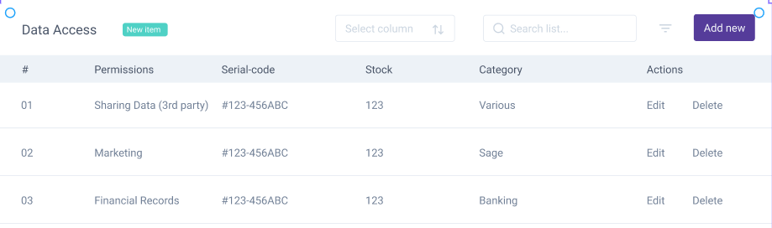
A possible visualization of the output
Customers
A simple dashboard within the products.
Data handling transparency.
Giving full control of their data.

Slide 13
Costs & Benefits
Over 65% of Sage's recurring revenue (around 280 million pounds) comes from cloud services, which highlights the importance of customer-oriented ethical policies.
Protect current revenue through protection of company's public reputation.
Potential to become disruptor in new markets offering currently unavailable services e.g., selling customer data to 3rd parties.
Total cost of ~£270,500.

Slide 14

Thank You! Any Questions?

Slide 15
Costs
Process | Cost (£)
Initial Development | 6,500
Social Media | 1,000 per month
Surveyors | 15,000 / region
Data Engineers (Ethical Boundaries) | 75,000
Developers (Unique ID System) | 50,000
Total | 270,500

Slide 16
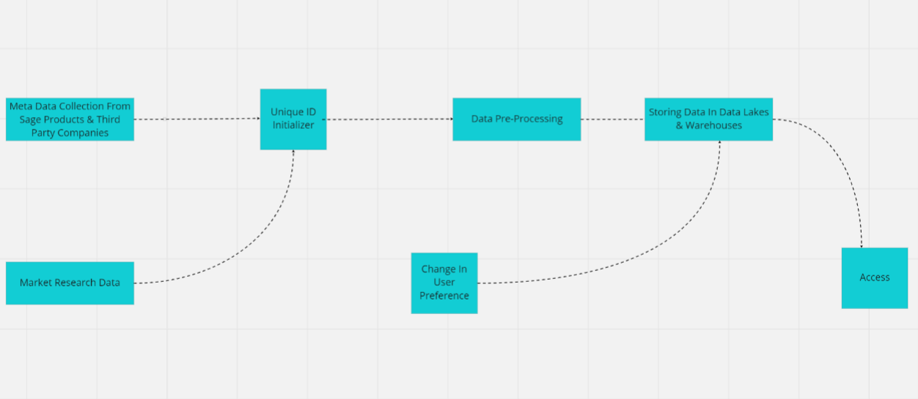
Work structure

